Slide 1
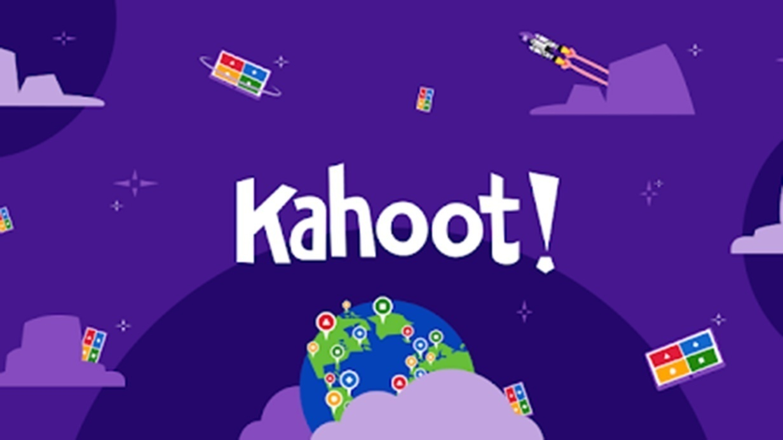
4GDP Webinars: 25-26.01.23 Part 1: Kahoot!

Slide 2
4G Didactic Pills
The project aims to produce short multimedia contents which we have called “Didactic Pills” (to be used with PC/Mac, tablet or smartphone) addressing the “life competences” (LIFE SKILLS) whose importance has been underlined by many European documents.
The Didactic Pills present problematic stories and different options for dealing with them. The Didactic Pills aim to stimulate students to reflect and to encourage discussion among peers and with teachers in order to make students better understand the importance of acquiring life skills.

Slide 3
Benefits of using interactive learning materials
Increased engagement
Sharpened critical thinking skills
Opportunities to practice
Situations as close to reality as possible
Cooperation and team work
Boosted motivation

Slide 4
Kahoot!
Kahoot! is a game-based digital learning platform used by millions of people around the world every day.
Today, Kahoot! is used by approximately 9 million teachers globally, hundreds of millions of students and families, and in 97% of Fortune 500 companies.
It uses quiz-style games that makes it easy to create, share and play learning games or trivia quizzes in minutes.
At school, Kahoot! can be used for any subject, any age, and with any device – students don’t even need to register for an account.
You can use Kahoot! both when teaching in class, for distance learning and in a blended learning format.

Slide 5
What is Kahoot!?
Kahoot! is a game-based learning platform used to review students' knowledge, for formative assessment or as a break from traditional classroom activities (Wang&Tahir, 2020).
The platform is among the most popular within game-based learning, with over 70 million monthly active unique users and used by 50% of US K-12 students (Lunden, 2018).

Slide 6
Why is Kahoot! special?
Kahoot! was the first student response system (SRS) designed to provide a game experience using game design principles from theory on intrinsic motivation (Thomas W Malone, 1981) and gameflow (Sweetser & Wyeth, 2005).
Flow occurs when the player enters a mental state, often in an environment where the challenges match the player's abilities (Csikszentmihalyi & LeFevre, 1989)
Kahoot! is, therefore, a combination of using audience responses, role-plays and, using video and audiovisual aids (Wang&Tahir, 2020).

Slide 7
What is the goal of Kahoot!?
The concept of Kahoot! is to combine an SRS, the existing technical infrastructure in schools, the fact that students are bringing their own digital devices, social networking, and gaming into one learning platform (Wang&Tahir, 2020).
The goal of Kahoot! is to increase engagement, motivation, enjoyment, and concentration to improve learning performance and classroom dynamics. Boredom in a computer learning environment can cause inferior learning and problem behavior (Baker, D'Mello, Rodrigo, & Graesser, 2010).

Slide 8
Millions of teachers use Kahoot to…
Introduce new topics
Give the students a chance to feel motivated to keep learning
Engage their class via distance learning and/or with interactive lessons
Review content in class and at home
Track learning progress and run formative assessment
Collect student opinions through instant feedback
Foster creativity and teamwork

Slide 9
Kahoot!’s Mission
Mission:
Make learning awesome!
“To make learning awesome! At Kahoot!, we are all about lifelong learning. In life, we learn new skills through curiosity and play. By combining the two, in a fun and social way, we can unlock the learning potential within all of us, no matter the subject, age or ability”

Slide 10
Researchers on Kahoot...
Wang, A. I., & Tahir, R. (2020). The effect of using Kahoot! for learning – A literature review. Computers & Education, 149, 103818. https://doi.org/10.1016/j.compedu.2020.103818
The literature review includes 93 studies, and the main conclusion is that Kahoot! can have a positive effect on learning performance, classroom dynamics, students' and teachers' attitudes, and students’ anxiety.

Slide 11
Researchers on Kahoot...
The main challenges mentioned by students include technical problems such as unreliable internet connections, hard to read questions and answers on a projected screen, not being able to change answer after submission, stressful time-pressure for giving answers, not enough time to answer, afraid of losing, and hard to catch up if an incorrect answer had been given.
Further, the main challenges mentioned by teachers include getting the difficulty level of questions and answers right, problems related to network connectivity, scoring based on how quickly the students answer reducing student reflection and cause some students to guess without thinking, that some students can have a problem with failing a quiz, and some teachers find it challenging to use the technology.

Slide 12
Welcome to Kahoot!
The software allows to create fun and quick learning games from scratch called “kahoots”.
The format and number of questions is up to the creator that can add videos, images, and diagrams in order to amplify engagement.
Kahoots, ideal for both hybrid and distance learning use, are usually best played in group settings and you need a unique PIN to join any game.
For the game host, it is recommended to use a big screen.
In addition to live games, you can also send kahoot challenges that players complete at their own pace – for example, for homework or remote training.

Slide 13
To create a kahoot, you can follow the following steps:
- Specify whether you work in a school, a higher education institution, or in school administration.
- Then choose a plan: you can use Kahoot! for free, or upgrade to one of premium plans to unlock additional features. You can decide to upgrade at any time.
1. Go to www.kahoot.com and log in (or sign up) as a teacher

Slide 14
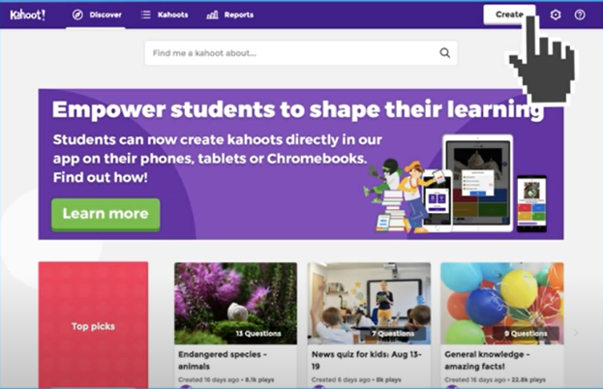
2. Click the “Create” button on top of the page to start creating your Kahoot

Slide 15
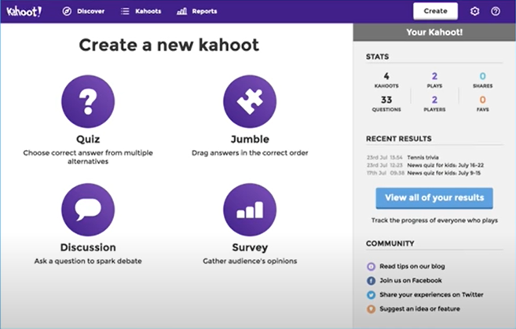
A quiz with multiple choice questions
- A jumble, in which the students will need to put the answers in the right order
- A discussion, that allows you to ask one question and to start a debate out of it (without points)
- A survey (essentially a poll without points to gather opinions)
3. Pick the game type that best suits you

Slide 16
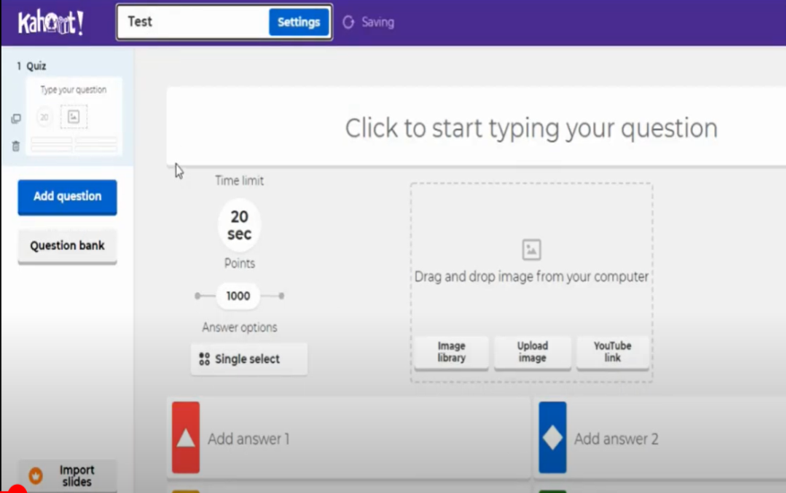
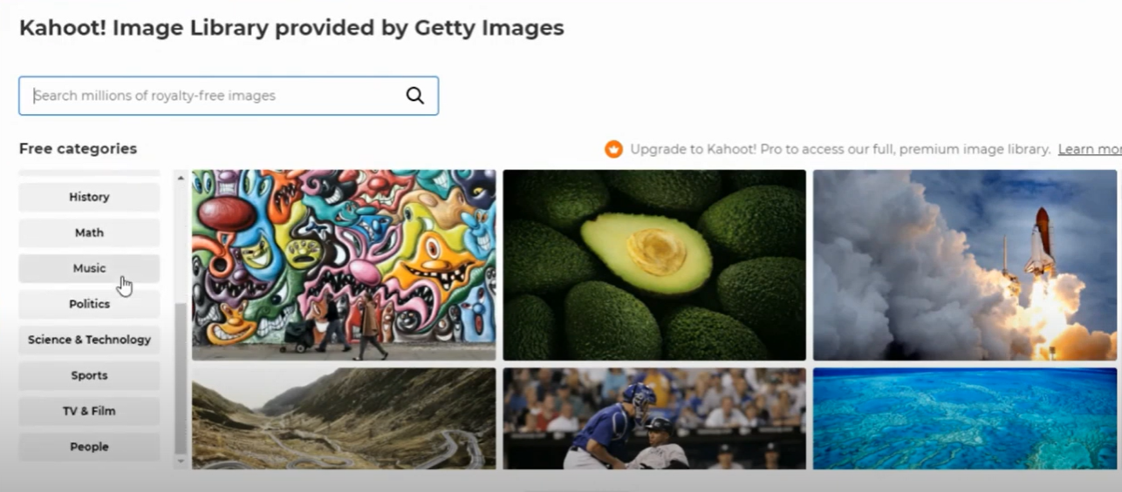
Start customizing the question and the answer alternatives, adding images (by uploading them from your computer or by choosing one from the online library), and/or embedding a YouTube link to the question.
4. Customize your kahoot

Slide 17
Customizing your kahoot
You also have the possibility to adjust game options - for example, randomize the order of questions,
You can enable a friendly nickname generator to avoid inappropriate nicknames.
You can choose whether students play individually (Classic mode) or in Team mode.
You can have up to 50 players.

Slide 18
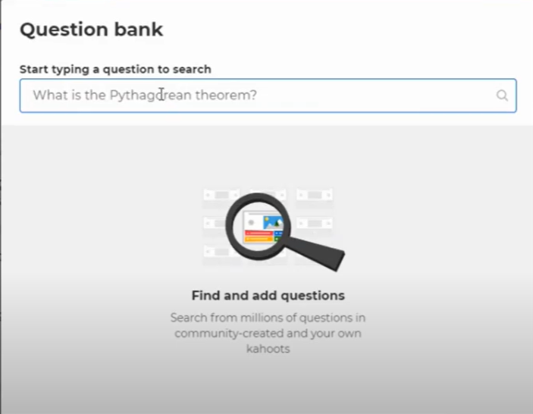
Customizing your kahoot
Instead of typing questions from scratch, you can add them from the website’s question bank – accessible from the left-hand side of the kahoot creator.

Slide 19
How to get students playing
By default, questions are displayed on a shared screen, while students tap answer tiles on their devices. If you’d like students to see questions and answer alternatives on their devices (for example, if you have a large classroom or students are joining remotely), toggle this setting on: Show question and answers on players’ devices.
A unique Game PIN will be displayed at the top of the screen. Students enter this PIN to join the live kahoot in the Kahoot! app or at kahoot.it in their browser.
Click Start once you can see all the players’ nicknames in the “lobby”.
During playing you can use the spacebar or your mouse to go to the next question.
After the kahoot, you can always find and assess results in the Reports section.

Slide 20
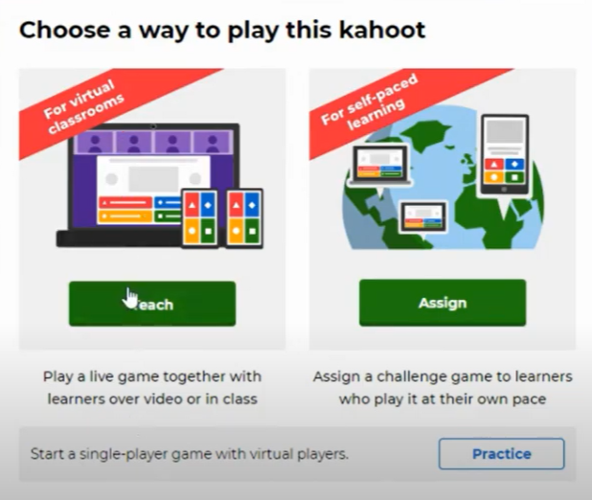
- Once your kahoot is set up, it is part of your collection of kahoots and you can choose whether to test it, to play it, or to share it with other people.
- If you click play, you can decide whether it is going to be immediately synchronous (then you click “teach”) or asynchronous (then you click “assign”).
5. The kahoot is ready to be played

Slide 21
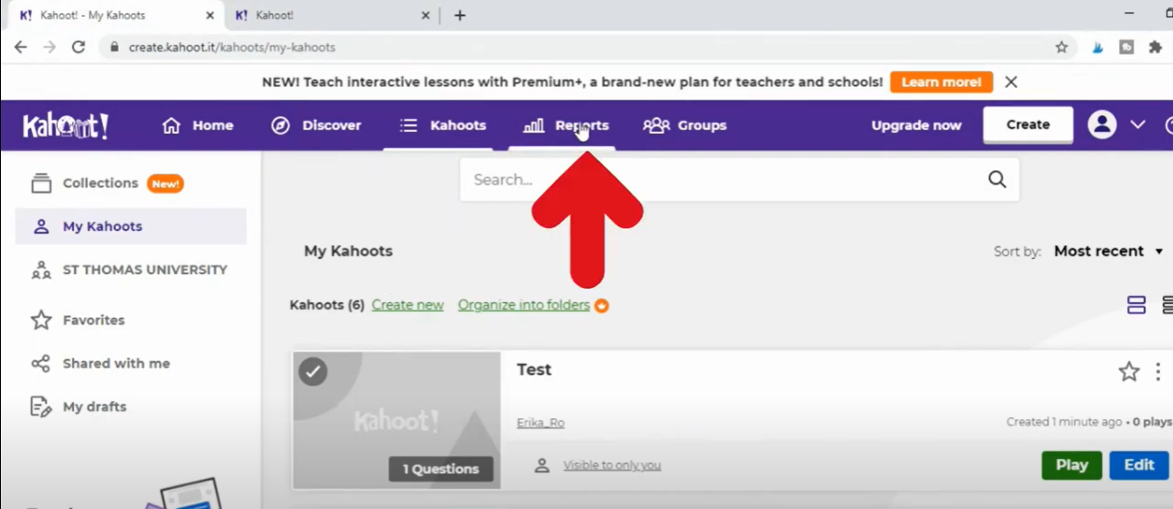
Once you have hosted a game, you can access the “reports” tab in the top navigation bar, that will show you:
- All the key stats (how many students played, how many questions there were, etc.)
- Which questions were the most difficult and might need re-teaching
- Which players need help based on their game results
- All the past games that were played (including anonymous surveys)
6. After the game is over – assessing learning results

Slide 22
Assessing learning results
In the “Questions” view you can identify where exactly key challenges occur. Be sure to look at the correct overall percentage of the question and at how long it took (in seconds) for students to answer.
In the “Players” view you can check which student (via their nickname) is answering incorrectly and how long are they taking to answer.
If less than 35% of students answered a question correctly, that question is labelled as “difficult”. If there were 3 or more difficult questions in the game you hosted, you can generate a new one with them to reinforce learning power up content review and prep for exams.

Slide 23
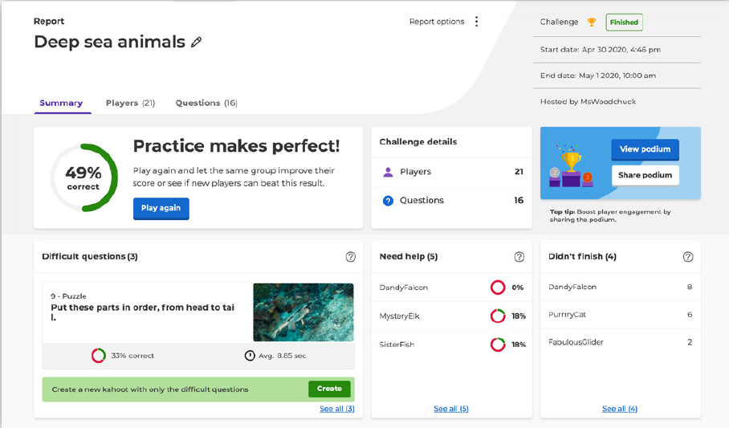
Assessing learning results
This section thus allows you to assess learning results and better target your further instruction by capturing useful instructional insights for formative assessment.

Slide 24
Useful tips
If you log in to your Kahoot account and navigate to “Discover” from the top bar, you can access millions of pre-set kahoots, many of which are high-quality ones. For example, you can have a look at collections such as the “Academy Verified educators” one, the “Academy Premium partners” one or the “Top picks” one.

Slide 25
Useful tips
If you’re looking for something specific, get started by typing a keyword or phrase into the search bar at the top of the Discover section. The system will suggest popular kahoots that fit your search terms.
If you want to dig deeper, you can filter by Subject, Grade Level, and other filters. When you find a kahoot you like, you can play it right away, add it to your Favorites, or duplicate it to be able to customize it later.

Slide 26
3 useful strategies
Use videos (you can add in videos right from YouTube very easily and question students after they have watched them)
Play with ghosts (Ghost is a feature that allows students to play against their own previous high scores. )
Let students create their own quizzes

Slide 27
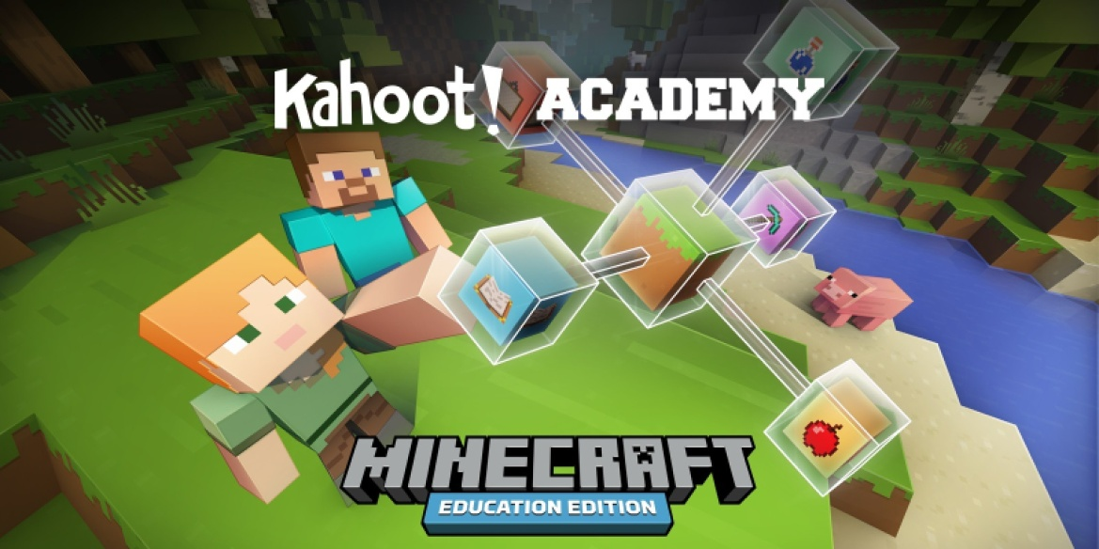
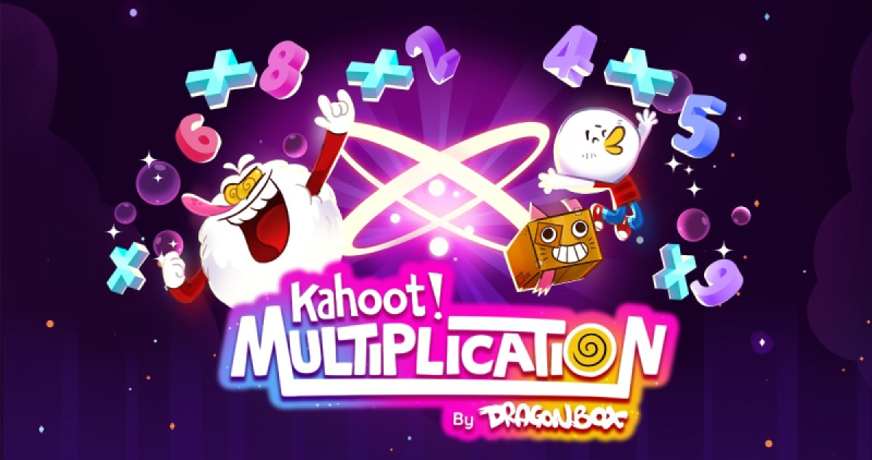
Recent apps
Kahoot! Academy: Minecraft education edition
Kahoot! Multiplication

