Slide 1
4GDP Webinars: 25-26.01.23 Part 2: Genially

Slide 2
4G Didactic Pills
The project aims to produce short multimedia contents which we have called “Didactic Pills” (to be used with PC/Mac, tablet or smartphone) addressing the “life competences” (LIFE SKILLS) whose importance has been underlined by many European documents.
The Didactic Pills present problematic stories and different options for dealing with them. The Didactic Pills aim to stimulate students to reflect and to encourage discussion among peers and with teachers in order to make students better understand the importance of acquiring life skills.

Slide 3
Benefits of using interactive learning materials
Increased engagement
Sharpened critical thinking skills
Opportunities to practice
Situations as close to reality as possible
Cooperation and team work
Boosted motivation

Slide 4
What is Genially?
Genially is an online and freemium platform for the creation of animated and interactive digital content. It is in fact a tool that lends itself to being used in education, in order to facilitate the teaching-learning process both in presence and at a distance.
Benefits:
very simple and intuitive user interface
pre-set templates
a wide range of products with great visual impact
the multimedia nature of the creations (text, images, audio, video)
the possibility of sharing one's work with others and working together on the same project

Slide 5
What can be achieved with Genially?
Presentations
Genially offers the possibility of creating presentations or video presentations that can be used by teachers, for the introduction of new topics (also in flipped classroom mode), or by pupils, as support for the presentation of their own in-depth research or group work.

Slide 6
What can be achieved with Genially?
Explaining from an image
Genially allows us to let images speak for themselves. By creating an interactive image we can in fact enrich our images with other layers of information (video, audio, text, etc.). This allows teachers to launch new topics from a visual stimulus (a painting, a photograph, a map, etc.), but also allows children to demonstrate what they have learnt or, more generally, to express themselves using a creative mode of expression.

Slide 7
What can be achieved with Genially?
Schematising
With Genially, it is possible to create infographics to schematise the topics explained or studied, translating them into an accessible and inclusive visual language.
Illustrate topics, practices and procedures
Genially provides the possibility of constructing guides, i.e. interactive information documents that neatly bring together the information needed for initial understanding or practical guidance on a study topic, practice or procedure.

Slide 8
What can be achieved with Genially?
Learning by playing
Genially allows us to create games and quizzes to motivate pupils, actively involve them in the teaching-learning process, assess and promote the memorisation of concepts through fun.
Creating learning modules
Genially allows us to create training materials that are true learning modules in which learning units are combined with challenges.

Slide 9
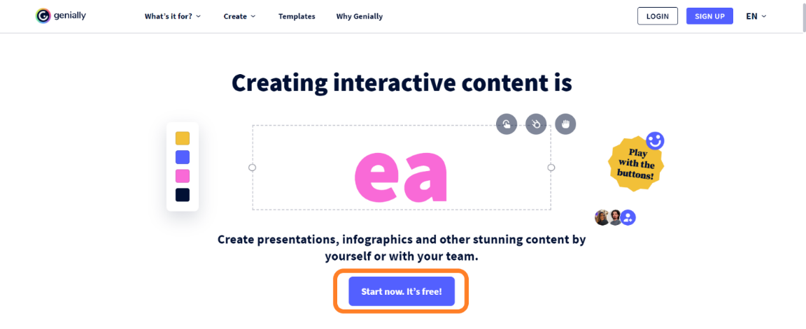
How to register?
To start using Genially, you must first register.
You therefore need to go to the home page (https://genial.ly) and click on the 'Start now. It's free!' button.

Slide 10
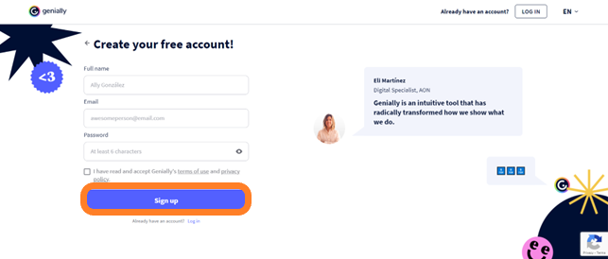
How to register?
You can choose whether to register with your Google, Facebook, Office 365, Twitter or Linkedin account, or with your e-mail.

Slide 11
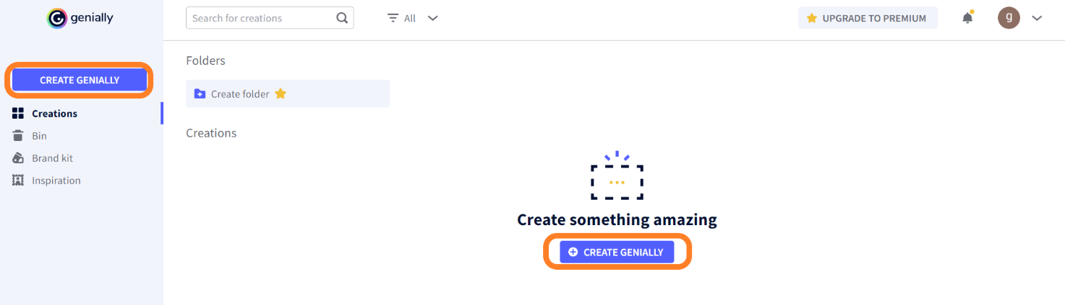
How to start creating?
To start a new project, click on 'Create genially' button (In the Panel you will find it both in the menu on the left and in the centre of the page) and choose the type of content you want to create from the options offered.

Slide 12
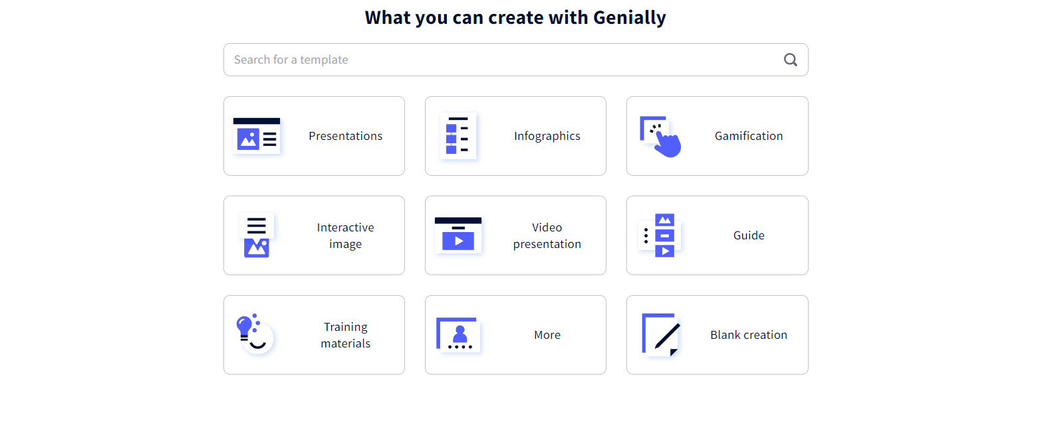
How to start creating?

Slide 13
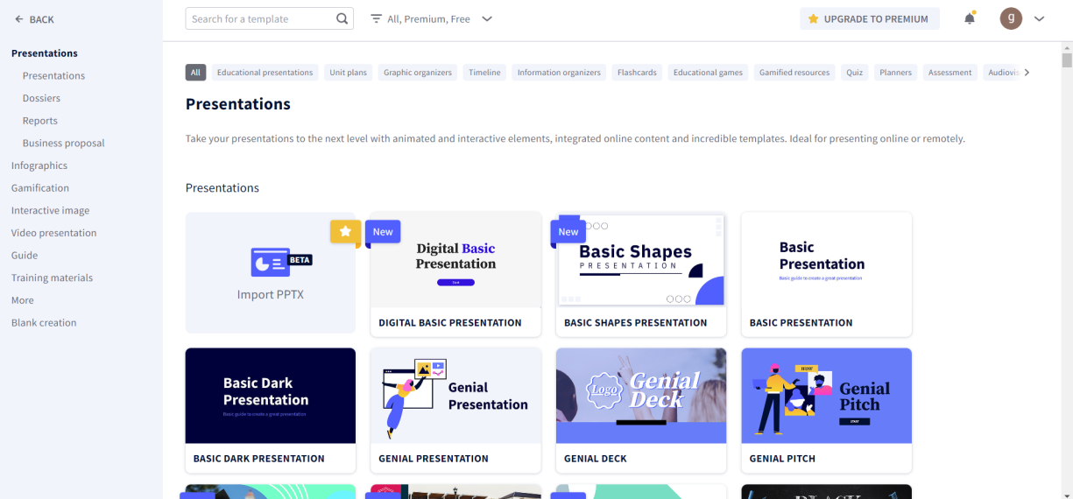
How to start creating?
You will then see a series of templates from which you can choose the one that best suits your specific needs. To speed up the search process and find what you need more quickly, you can filter the templates using the search engine.

Slide 14
How to start creating?
If you do not find a template here that satisfies you, you can look for inspiration in the Genially Community.
In the menu on the left-hand side of the Panel, click on the 'Inspiration' section. You will access the rich repertoire of creations made by other users in the community.
You can use the search bar to find what you need more easily or filter the results to quickly find reusable geniallys.

Slide 15
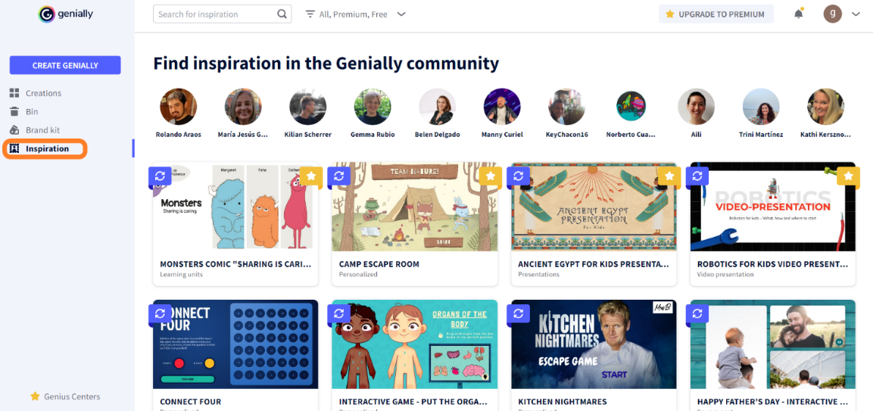
How to start creating?

Slide 16
How to start creating?
If you prefer not to use a pre-set template, you can choose to create your content from a blank page. In this case, after clicking on 'Create genially', select 'Blank creation'.
Genially offers the possibility of working on a PowerPoint document, modifying its content and graphics and adding animations and interactive elements. If you want to use this function of Genially to breathe new life into your old presentations, all you have to do is click on 'Create genially', select 'Presentations' and then click on 'Import PPT'. You can import a file in .pptx format as long as it does not exceed 100 Mb.

Slide 17
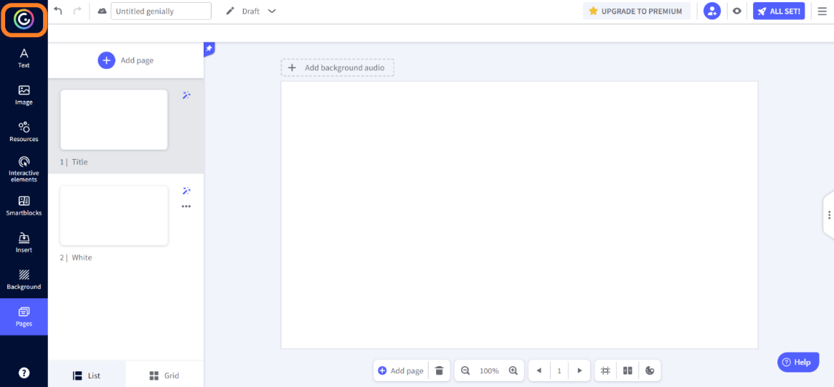
How to start creating?
After selecting the template, it will open in the Editor. To return to the Panel, click on the Genially icon in the top left corner.

Slide 18
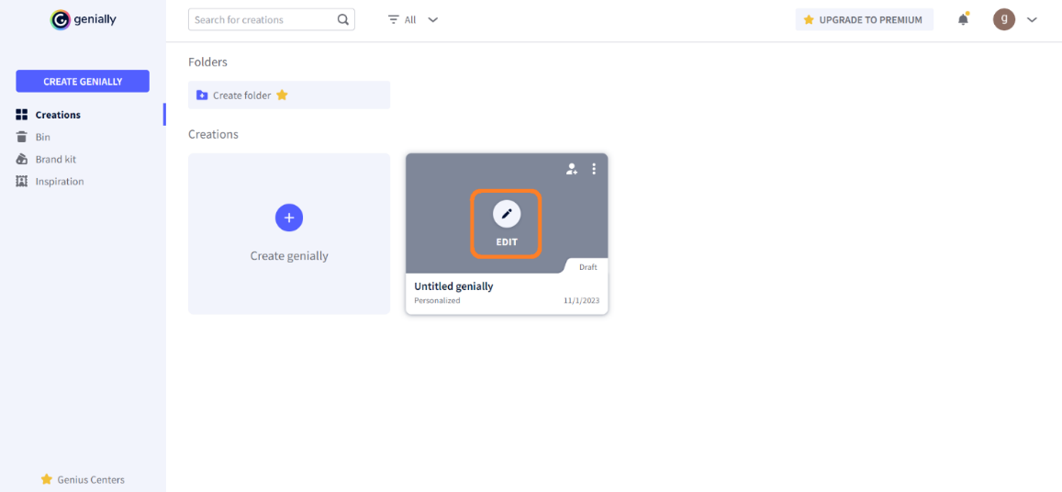
How to start creating?
The Panel is the place where you can view the thumbnails of your creations. To make changes to a creation, hover over its thumbnail and click on the ‘Edit’ button.

Slide 19
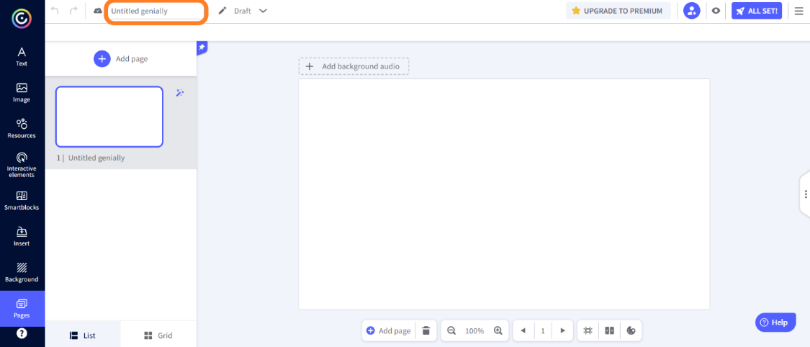
How to assign a title to a genially?
Variant 1: From the Editor, all you have to do is enter the title in the text box on the top bar. The changes will be saved automatically after a few seconds. To speed up the saving process, you can click on the little cloud icon.

Slide 20
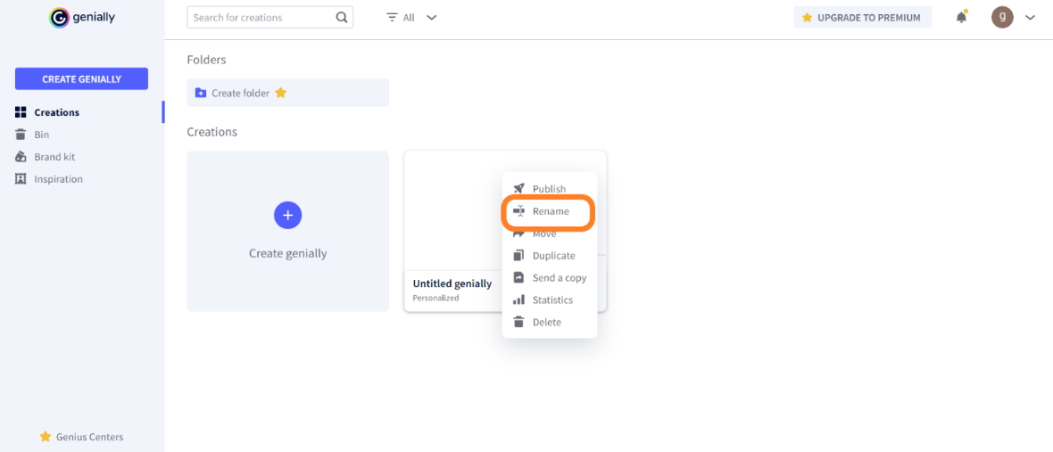
How to assign a title to a genially?
Variant 2: From the panel, you must instead hover over the project thumbnail, click on the three dots that appear in the top right-hand corner and then select the 'Rename' option.

Slide 21
How to collaborate with others on the same project?
Genially gives us the opportunity to work as a team and realise group creations.
Once you have created a project, you can decide to avail yourself of one or more collaborators to complete it. All collaborators will see the project in the 'Creations' section of their Panel and will have the possibility, one at a time, to make changes to it.

Slide 22
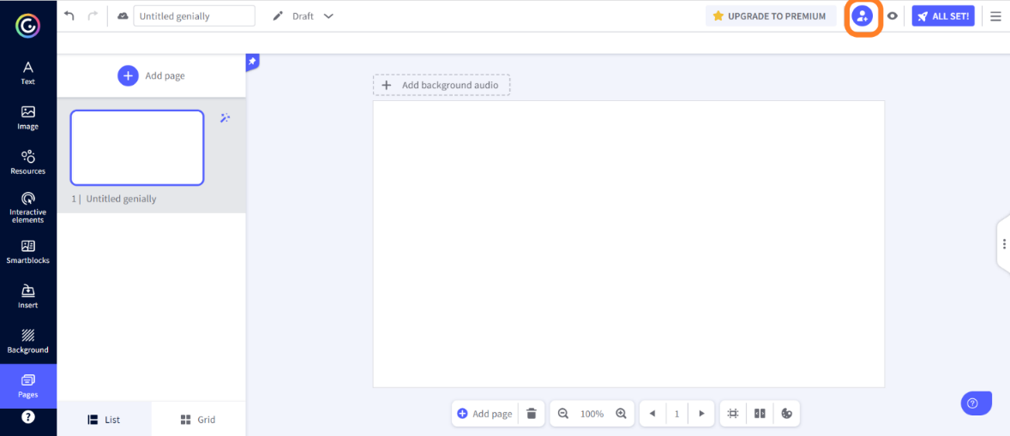
How to collaborate with others on the same project?
How to add collaborators? You can do this from the Editor or from the Panel. From the Editor, click on the collaboration icon located to the right on the top bar.

Slide 23
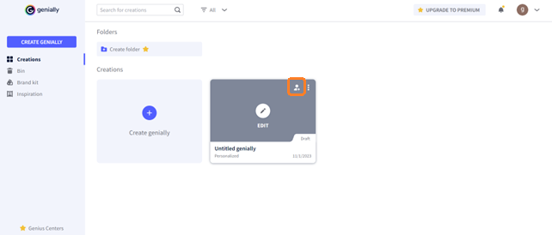
How to collaborate with others on the same project?
From the Panel, hover over the thumbnail of the genially you want to make collaborative and click on the collaboration icon.

Slide 24
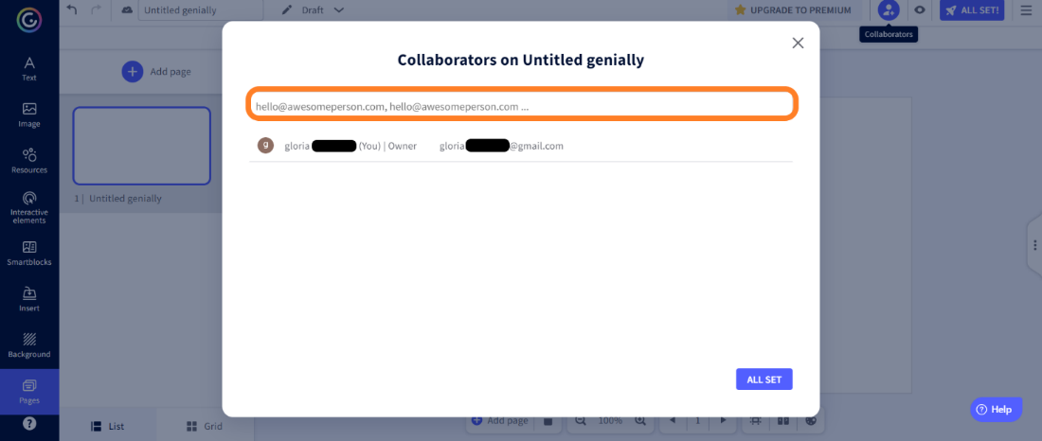
How to collaborate with others on the same project?
In both cases you will display a window where you will be allowed to enter the e-mail address of the person you wish to add as a collaborator. If you wish to add several collaborators, separate the different e-mail addresses with a comma.

Slide 25
What tools and functions do you have at your disposal?
Once you have created your genially and assigned it a title, you can start customising your creation. A number of tools and functions are available to you to do this.
Two menus are available in the Genially editor: a Main Menu and a Contextual Menu.

Slide 26
What tools and functions do you have at your disposal?
Main Menu
This menu, located within the sidebar on the left, provides the various resources that can be included in the creation by grouping them by type. Some of them are not available in the free version. To incorporate a resource within the creation, simply select it and drag it to the desired position with the mouse (drag and drop system).

Slide 27
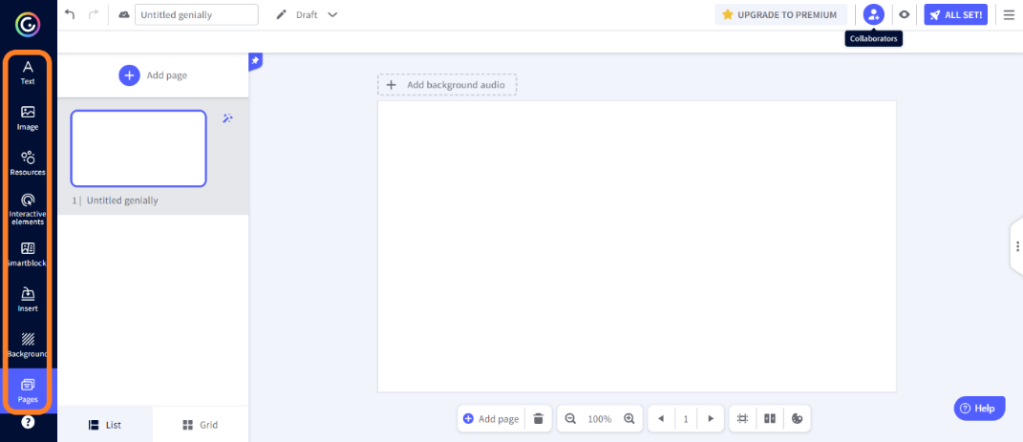
Main menu

Slide 28
Main Menu
Text
In this section you have various text boxes in different formats and a number of style sets that you can insert into your creation.
Image
Clicking on this section gives you several possibilities to insert images into your genially. You can choose from those provided by the platform, upload them from your device, Google Drive or Dropbox, or you can search for them on Pixabay or Giphy. Genially.ly gives you the opportunity to save space on your hard disk: by pasting the URL on your image you can embed it in your creation without having to download it.

Slide 29
Main Menu
Resources
This section gathers a wide variety of elements (icons, shapes, charts, lines, arrows, illustrations, scenes, maps or silhouettes) with which you can enrich your project.
Interactive elements
This section gathers a series of elements (such as buttons, markers or icons) that you can include in your creation and provide with interactivity.
Smartblocks
This section gives access to a large repertoire of smartblocks, i.e. sets of predefined elements with a variety of themes that will help you easily complete your creation.

Slide 30
Main Menu
Insert
From this section, you can insert audio, video or other multimedia content into your creation. Various options are offered. Resources can be, for example, uploaded from your own device, from Google Drive or Dropbox, or via links.
Background
From this section, you can customise the basic background and page background of your creation. You can choose a plain background by customising its colour, select a background from the Genially library or upload an external image.

Slide 31
Main Menu
Pages
From this section, you can edit and manage the pages that make up your creation. Pages can be added, deleted, duplicated, hidden or password-protected. By clicking on the magic wand at the top right of each page, you can open a menu that allows you to set the canvas size, transitions from one page to another and the navigation mode.

Slide 32
Contextual Menu
Contextual Menu
This menu, which is opened by clicking on any element of the creation, includes a series of functions that allow you to act on the selected element by locking it, inserting an interaction, adding an animation or replacing the element itself.

Slide 33
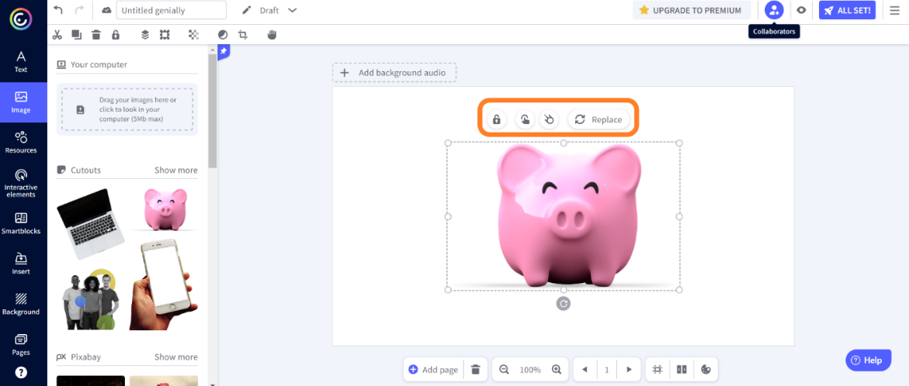
Contextual Menu

Slide 34
Contextual Menu
Lock
This function allows you to lock the selected element should you wish to modify the rest of the creation without running the risk of modifying it or changing its position by mistake.
Add interactivity
This function allows you to equip the selected element with interactivity. There are seven types of interactivity that can be configured.

Slide 35
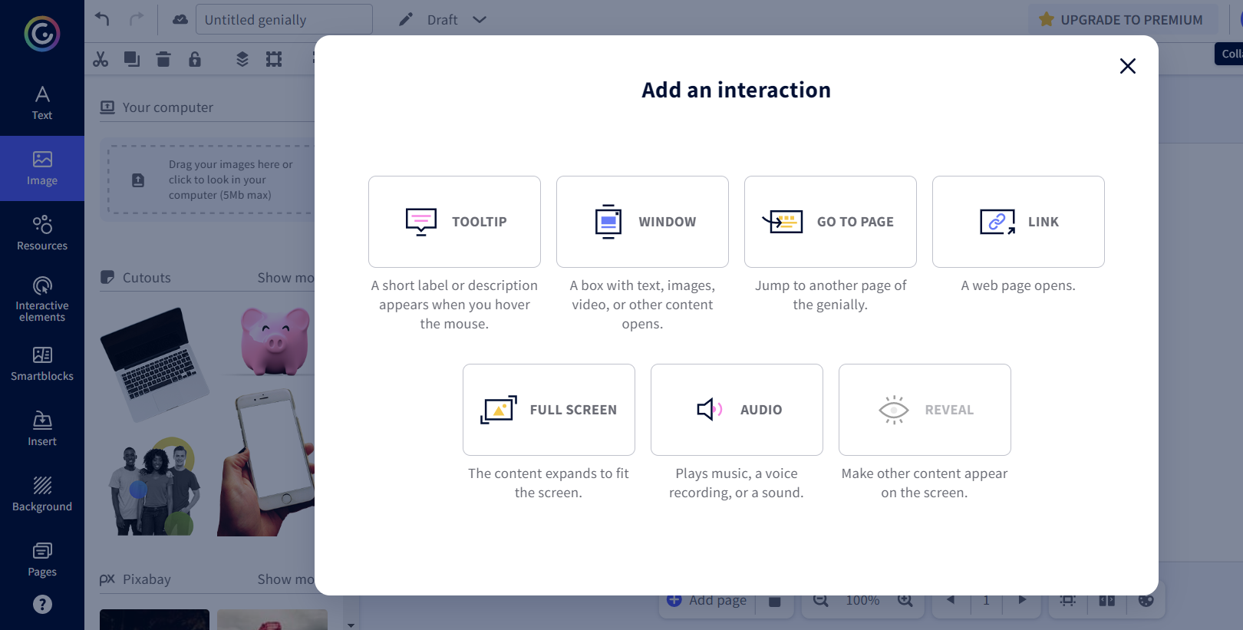
Add interactivity

Slide 36
Add interactivity
ToolTip:when the mouse hovers over the selected element, other elements (text, images, videos, links, tables, etc.) appear on the screen.
Windows: clicking on the interactive element opens a window with text, images, videos or other content.
Go To Page: clicking on the interactive element automatically switches to another page in the creation.
Link: clicking on the interactive element opens a web page.
Full Screen: clicking on the interactive element expands it to fill the entire screen.
Audio: clicking on the interactive element starts an audio.
Reveal: clicking on the interactive element displays previously hidden content on the screen.

Slide 37
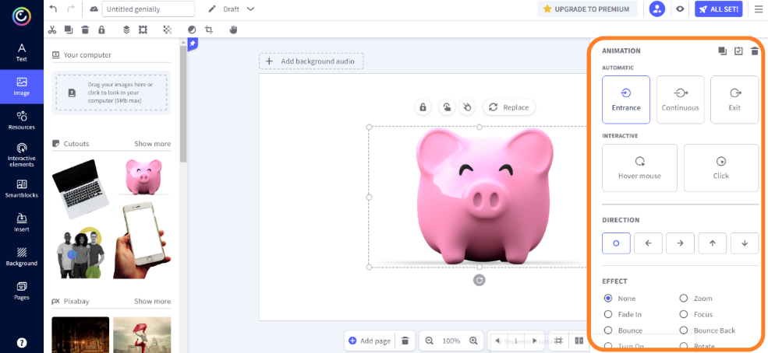
Edit animation
Edit animation
This function allows the selected element to be brought to life with one or more animations.

Slide 38
How to publish your creations?
As you proceed with editing your creation, Genially saves your progress automatically. Once you have finished your work, you are ready to publish it. You can choose whether you want it to be public, i.e., visible to anyone, indexed in search engines, or private, i.e., visible only to people with whom you share the display link. This second option is only available to those who purchase the Premium version.

Slide 39
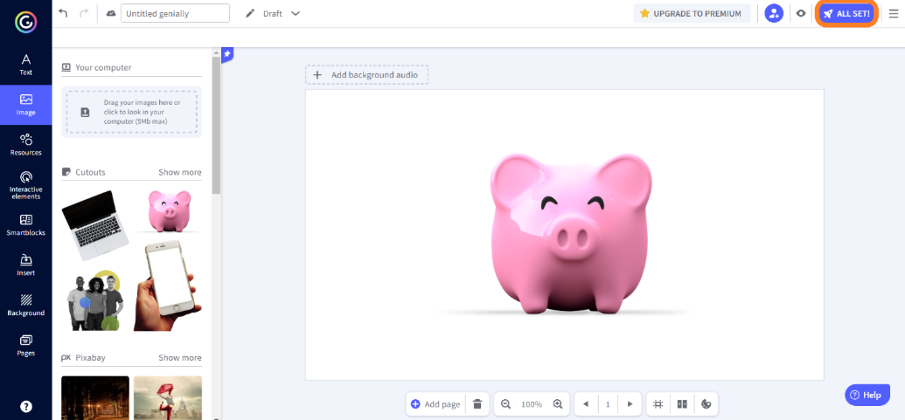
How to publish your creations?
You can publish your genially from the Editor or from the Panel. If you are in the Editor, click on the 'All set!' button at the top right.

Slide 40
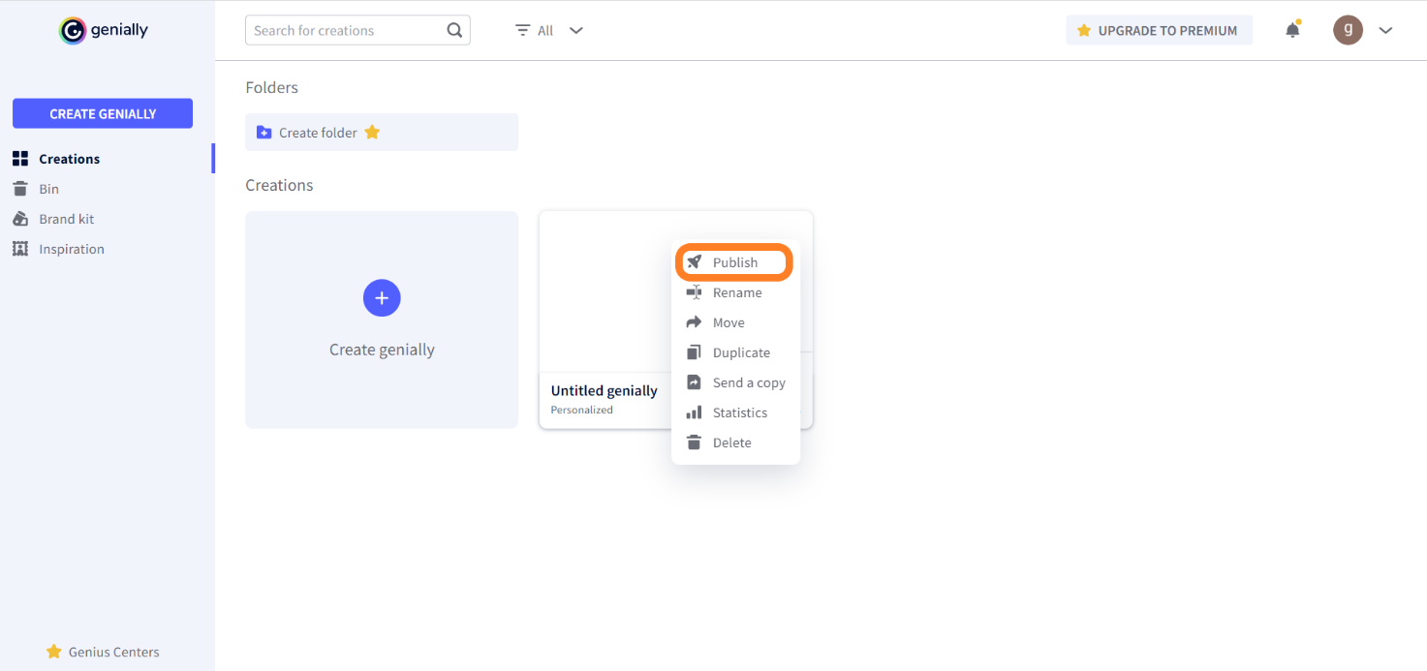
How to publish your creations?
If you are in the Panel, hover your mouse over the thumbnail of the presentation you want to publish, click on the three dots at the top right of the thumbnail, and then click on 'Publish'.

Slide 41
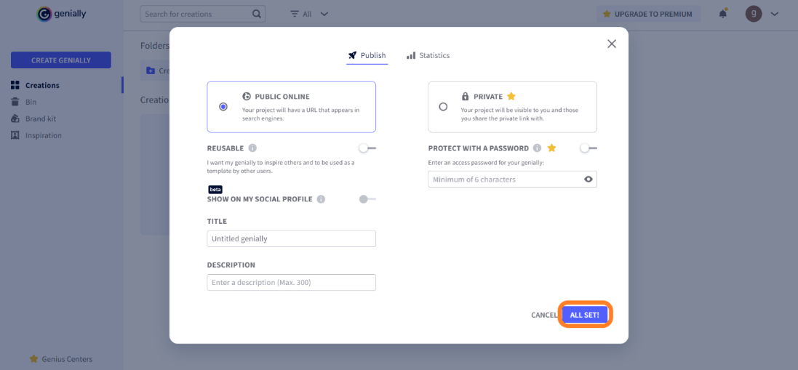
How to publish your creations?
Choose the publishing mode and then click on 'All set!'. Your genially is now ready to be shared or downloaded.

Slide 42
How to share or download your creations?
Once you have published your creation, you can share it with whoever you want. Go to the Panel. Hover over the thumbnail of your creation and you will see the share icon. Click on the icon. You will have several options:
Link sharing
Embedding in a website or blog via Iframe script
Sending by e-mail
Sharing on social media
Sharing on Google Classroom
Sharing on Microsoft Teams

Slide 43
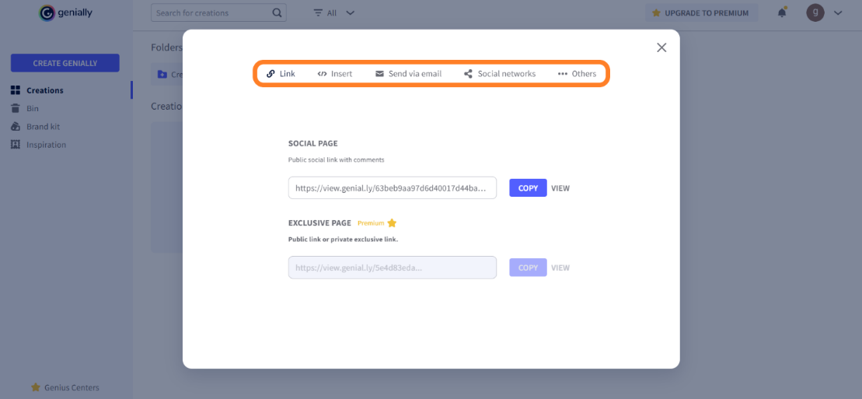
How to share or download your creations?

Slide 44
How to share or download your creations?
After publication, if you have purchased the Premium version, you also have the option of downloading your creation. Once again, you will have to hover over the thumbnail of the genially you want to download. This time click on the download icon. You will be able to choose in which format you want to download your work:
PDF
JPG
HTML
MP4

Slide 45
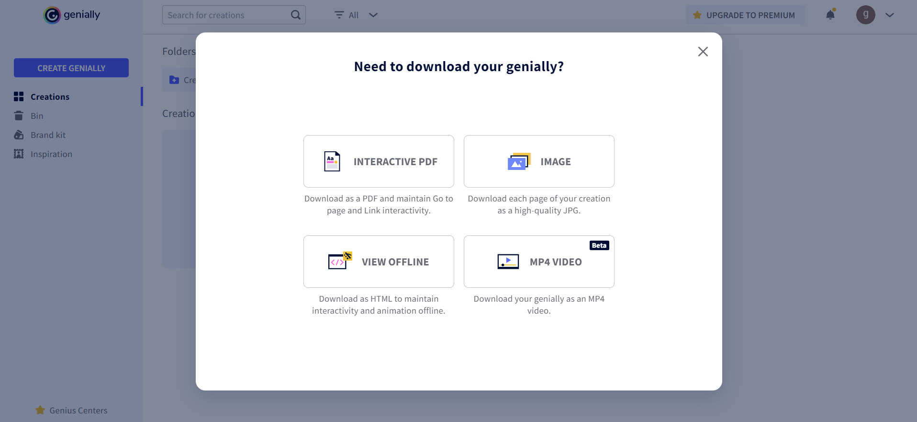
How to share or download your creations?

