Slide 1
4GDP Webinars: 25-26.01.23 Part 3: Canva

Slide 2
4G Didactic Pills
The project aims to produce short multimedia contents which we have called “Didactic Pills” (to be used with PC/Mac, tablet or smartphone) addressing the “life competences” (LIFE SKILLS) whose importance has been underlined by many European documents.
The Didactic Pills present problematic stories and different options for dealing with them. The Didactic Pills aim to stimulate students to reflect and to encourage discussion among peers and with teachers in order to make students better understand the importance of acquiring life skills.

Slide 3
Benefits of using interactive learning materials
Increased engagement
Sharpened critical thinking skills
Opportunities to practice
Situations as close to reality as possible
Cooperation and team work
Boosted motivation

Slide 4
What is Canva?
Canva is an easy-to-use graphic design platform that allows you to create visual content, including social media graphics, posters, flyers and more.
The Canva editor is intuitive to help you explore and experiment with design tools at your own pace.
Canva has thousands of templates to help you start inspired. They’re a great way to learn how different elements work together to create eye-catching designs.
It’s available to use in your browser or as a mobile app.
After creating your piece, it can be downloaded as an image file or PDF and immediately shared or is ready to print.

Slide 5
Canva’s top menu
The Home button is always there to help you return home no matter where your design adventures may take you.
Templates is full of thousands of designs you can customize to make your own, organized into different categories to help you easily find what you need.
Features shows you photos, icons, print media, apps and more to help you design what you need.
Learn has blog articles, short tutorials and in-depth courses to help you learn more about design. And
Pricing shows you how to go Pro or apply for a not-for-profit account.

Slide 6
Canva’s top menu

Slide 7
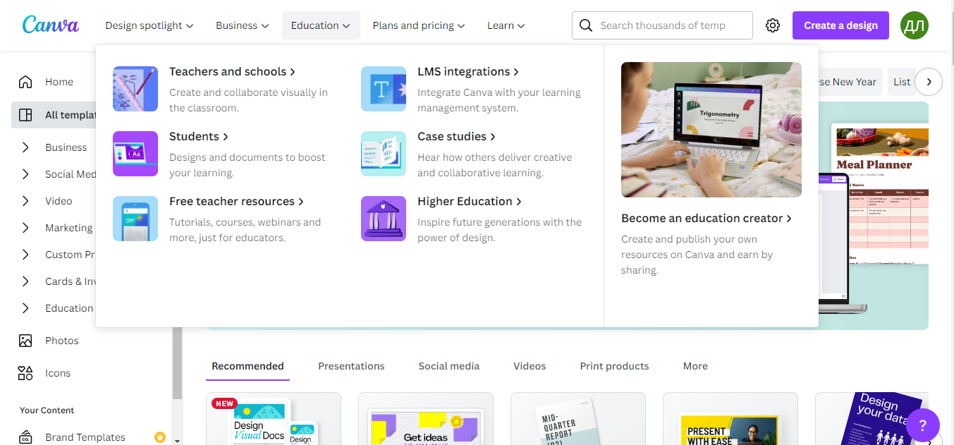
Education tab

Slide 8
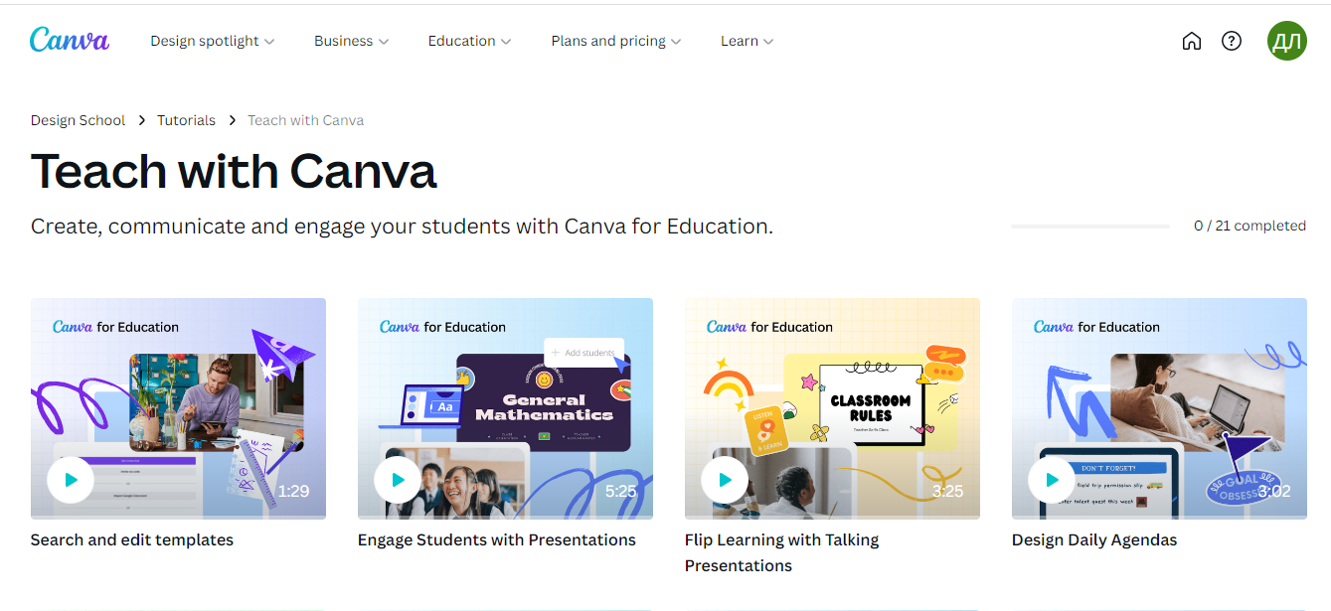
Free teacher resources

Slide 9
Canva’s side menu
There’s another Home button for you in case you need to reset after a deep dive somewhere.
Then there’s Your projects – this is where you can find, and organize, all your designs. It’s organized into sections so you can find what you’re looking for quickly. You can create folders to keep things tidy and share individual designs.
The next button is Templates. This takes you through to thousands of designs to help you start inspired and show you ideas for different design assets.
There’s a recommended tab that shows you some things you may like based on your designs, as well as templates for heaps of other design assets.
The Shared with you page is where you’ll find any designs someone has shared with you.
Next is Trash, any designs, images or videos you’ve deleted will appear here until you permanently delete them.

Slide 10
Using and customizing templates
One of the best resources for fast-tracking your design up-skilling is the nearly endless library of templates. Templates are made by expert designers and show you what’s possible in Canva as well as showing you good design principles in practice.
Find Templates in the top menu or simply use the search bar to find what you need.
Once you find a template you like, open it in the editor and you’ll see that all the design elements can be customized and edited to best suit your design needs.
You can remove, resize, change the color and position, even duplicate elements to best suit your design. Templates help you get inspired.

Slide 11
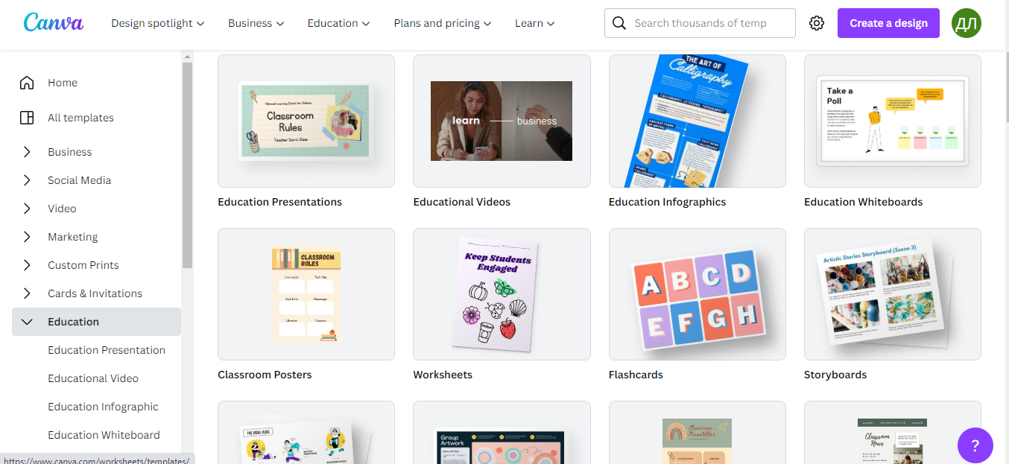
Using and customizing templates

Slide 12
Using and editing elements
Canva has a huge library of design elements – most are free to use and some are for pro accounts and some have a small fee.
In the side tab, click Elements. Use the search bar to find options around a keyword, scroll sideways through different categories, or scroll down to see some example elements for different categories.
Once you find what you need, double click, or click and drag, to add the element to your design. Then, you can customize it as you need. Change the color, resize and reposition until you design is finished.

Slide 13
Using and editing elements

Slide 14
Uploading and using media
To upload content – it can be photos, illustration, and video – click on Uploads in the side panel, then Upload Media.
You can also click and drag media directly into a design. Once you’ve uploaded media, it will appear in the Uploads tab.
Add them to your design and you can edit, customize and resize your assets as you need.

Slide 15
Uploading and using media

Slide 16
Finding fonts and using text
To add text to your design, go to the text button in the side panel.
Search for font styles in the search bar, or use one of the three preset text styles to easily click and drag heading, subheading or body text.
Scroll down for font combinations and styles and double click or click and drag to add to you design.
To change the font, size, color, alignment – anything with your text – simply click on it and a text editor menu will appear.
You’ll find more text editing options if you click the three dots at the right end of the text editing menu.

Slide 17
Finding fonts and using text

Slide 18
Sharing and collaborating on designs
When you’re ready to share a design, you can download to share it or share access with a collaborator.
To add a collaborator, who can leave feedback as comments in your design, in the top right corner click Share. Type in their email address, include a message or notes, set their level of access (options include full edit access, can comment, can view (can’t comment or edit) and then click send.
Other sharing options you’ll see below the copy link button include presenting your design, and presenting and recording.
You can download your design, share it straight to social media or use the printing portal for heaps of printing options.
And if you can’t find a sharing option you’re seeking, click More for even more sharing options.

Slide 19
Saving and organizing documents
Canva autosaves your desing as you go.
If you want to manually save your design to a specific folder, in the top menu click File, then Save to folder, then choose your desired folder. You can also create a new folder there too.
To find your folders or a design click back to the home page, then Your projects and you’ll see your Folder section just below the Recent designs section. Keep scrolling down to see your individual designs.

